Slide 1
What is problem solving?
The process of working through a problem to find a solution
Not just math
Is an essential skill you need for work, learning and independence

Slide 2
Definitions
Problem: Wherever there is a gap between where you are now and where you want to be and you don’t know how to cross that gap, you have a problem. (Hays, 1980)
Problem solving: What you do when you don’t know what to do. (Wheatley, 1984)

Slide 3
Problem Solving Steps
Step #1: Identify the problem
Step #2: Think about it
Step #3: Brainstorm solutions
Step #4: Select the best solution
Step #5: Implement the solution
Step #6: Evaluate the solution

Slide 4
Problem solving tools
Brainstorming
Flow chart
Check sheet
Run chart
Pareto chart
Cause and effect diagram
Five whys

Slide 5
Innovation/Creativity
Sources of new product ideas
Creativity: can it be learned?
Techniques for fostering group creativity
Increasing personal creativity

Slide 6
Left and Right Brain in Creativity
Left Brain
Symbols
Words
Logic
Judgement
Mathematics
Speaking
Creative Thinking
Right Brain
Sensory Images
Dreaming
Feeling
Intuition
Visualisation

Slide 7
Innovation/creativity
Creativity CAN be learned . If your organisation/group doesn’t make use of specific creative techniques, why not introduce them?
Be willing to think ‘whacky’ thoughts - collectively these can spark excellent ideas.
Be constantly receptive – creativity comes from the most unlikely sources!

Slide 8
Techniques for Eliciting Group Creativity
Technique Description
Need/Problem identification
- Based on asking people about the needs & problems they have with existing products
Attribute listing
- List major attributes and consider how to modify each one
Brainstorming
- Stimulate ideas in a group of 6 to 10 people in a non evaluative way
Lateral thinking
- Elicit ideas, using tools which by-pass “vertical,” rational logic

Slide 9

Problem-Solving Techniques Continued…
Seven steps for problem-solving can
be carried out.
1.) Identify the issues
- Be clear about what the problem is
2.) Understand everyone’s interests
-It is important to take the perspective of all that are involved to generate the best solution

Slide 10
Problem-Solving Techniques Continued…
3.) List possible solutions
- Brainstorm and use creativity to come up with ideas on how to solve the problem
4.) Evaluate the options
- Consider the pros and cons for given solutions
5.) Select an options or options
- Determine what is the best option and provides the most balancing solution to the problem. Consider also whether several solutions could be combined.

Slide 11
Problem-Solving Techniques
6.) Document any agreements
- if working in a group, note the agreement among members about solutions
7.) Implement, monitor, and evaluate solutions

Slide 12
Becoming Aware
To be an effective problem-solver, you need to have self-awareness about your:
Thinking processes, decision-making skills, learning style, intelligence, memory and information acquisition, and problem-solving skills and techniques

Slide 13

Critical thinking
Is not: automatic response or intuition etc
whatever their value or lack of value!
Critical thinking is reasonable reflective thinking that is focused on deciding what to believe or do (R. Ennis)
The significant problems we face cannot be solved at the same level of thinking we were at when we created them. Einstein

Slide 14

Critical Thinking: definitions
... Most formal definitions of critical thinking include the intentional application of rational, higher-order thinking skills such as analysis, synthesis, problem-recognition and problem-solving, inference and evaluation
T.A. Angelo. (1995). “Classroom assessment for critical thinking.” Teaching of Psychology, 22(1), p.6
Critical thinking is not simply being highly critical of everyone else’s thinking but your own
Anonymous (2002)

Slide 15
What is critical thinking?
Critical thinking involves thinking about questions and issues using a "blank page" point of view. It also involves understanding the difference between fact and opinion when you are doing research.
Critical thinking skills drive the decisions we make every day.
Critical thinking skills help us solve problems

Slide 16
Critical thinking skills are important because they support the ability to be able to problem-solve effectively and to make good decisions.

Slide 17
Critical Thinkers
ask questions
gather and assess relevant information
are open-minded
can communicate and work with others to solve problems

Slide 18
In order to develop and maintain critical thinking skills you need to use them.
One of the best ways to do this is to practice your problem-solving skills!

Slide 19
Brainstorming: Warning
PREMATURE EVALUATION WILL PREVENT CONCEPTION !

Slide 20
Definition of Brainstorming
“To practice a conference technique by which a group attempts to find a solution for a specific problem by amassing all the ideas spontaneously contributed by its members”
Osborn (inventor of brainstorming), 1953

Slide 21
Basic Rules of Brainstorming
No criticism whatsoever
Free-wheeling is welcome. The whackier the idea, the better
The more ideas, the better
Building on others’ ideas is encouraged

Slide 22
Brainstorming : Evaluation
Frequently used technique
Easy to implement
Time efficient
Prone to inaccurate usage
Research findings on usefulness are contradictory (both positive and negative)
Inconclusive

Slide 23
What Is Reverse Brainstorming?
Reverse brainstorming, sometimes called “negative brainstorming,” is a process that turns typical brainstorming upside down.

Slide 24
Instead of asking participants to come up with great ideas for improving a process or achieving a goal, you ask them to instead brainstorm ways to absolutely undermine a process or make a goal impossible to achieve.
You let all those pent-up negative thoughts bubble to the surface.
This provides the group with useful information about what isn’t working. Once you know what isn’t working, of course, you have the tools you need to plan for success.
The best way to envision the process of reverse brainstorming is to compare it to typical brainstorming:
Typical brainstorming question: How can we improve customer service?
Reverse brainstorming question: How can we make customer service so bad that every one of our customers walks away from our product or service?
Typical brainstorming question: How can we ensure that this project is a success
Reverse brainstorming question: How can we ensure that this project is a dismal failure?

Slide 25
How to Use the Tool
Clearly identify the problem or challenge, and write it down.
Reverse the problem or challenge by asking, "How could I possibly cause the problem?" or "How could I possibly achieve the opposite effect?"
Brainstorm the reverse problem to generate reverse solution ideas. Allow the brainstorm ideas to flow freely. Do not reject anything at this stage.
Once you have brainstormed all the ideas to solve the reverse problem, now reverse these into solution ideas for the original problem or challenge.
Evaluate these solution ideas. Can you see a potential solution? Can you see attributes of a potential solution?
Tip:
Reverse brainstorming is a good technique to try when it is difficult to identify solutions to the problem directly.

Slide 26
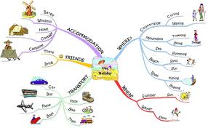
Mind maps
Show hierarchical relationships around a central idea or key word
Often hand drawn
Useful for planning, generating ideas, seeing connections
An alternative to using lists for planning assignments
Helps develop understanding & new ideas

Slide 27

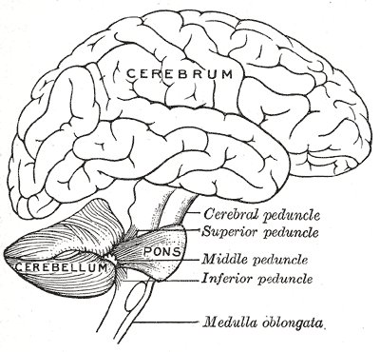
What is a mind map?
Mind mapping is a whole-brain method for generating and organizing ideas.
Illustration of the relationship between concepts and facts developed by moving from a general idea to specific instances

Slide 28
Conceptual Framework for Mind Map
Meaningful learning
Imagery
Information
reorganized
actively
Social context
Memories
Existing framework
Learner’s mind
Reading information
Hearing information
Visualizing information

Slide 29
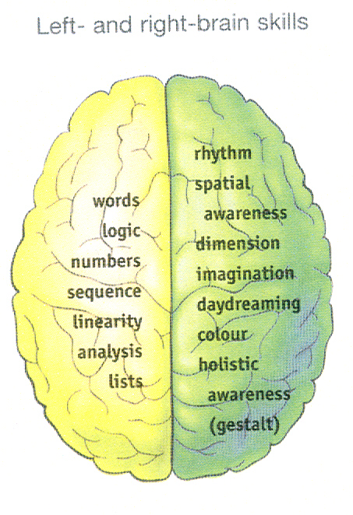
What do we know?
Regular practice using a MM will train you to be a more balanced thinker. You will be using both the left and right hemispheres of your brain.
left hemisphere is logical, analytical thinking
right hemisphere is imaginative, big-picture thinking
The more you practice this technique, the more powerful a thinker you will be.
The mind map learning technique is an active learning strategy that has been proposed to force learners to integrate information using visuospatial orientation and thus enhance learning (Farrand et al., 2002).

Slide 30
Rules of mind mapping
Start with a topic, a few colored pens, and a large, blank sheet of landscape paper Encourages skills More space in the writing direction
1. Begin your mind map with a symbol or picture that represents your topic. Draw the symbol in the center of the page. Starting at the center opens your mind to a full 360 degrees of association.
2. Write down key words, the information-rich “nuggets” of recall and creative association.
3. Connect the key words with lines radiating from your central image. By linking words with lines (branches), you’ll show clearly how one key word relates to another.
4. Print your key words. Printing is easier to read and remember than writing.

Slide 31
5. Print one key word per line This will allow you to discover the maximum number of creative associations for each key word.
6. Print your key words on the lines and make the length of the word the same as the line it is on.
7. Use colors, pictures, dimension, and codes for greater association and emphasis. Highlight important points and illustrate relationships between different branches of your mind map. Pictures and images, preferably in vivid color, should be used whenever possible; they stimulate your creative association and greatly enhance your memory.

Slide 32
In summary a mind map
Diagrammatically uses key words/images exploded from a central idea in a format that aids cognitive processing Central to peripheral
Multicolor
Multi pictures
Few or no propositions
Purpose: promote critical thinking, establish nonlinear relationship between concepts, enhances recall of information using dynamic colors & pictures

Slide 33
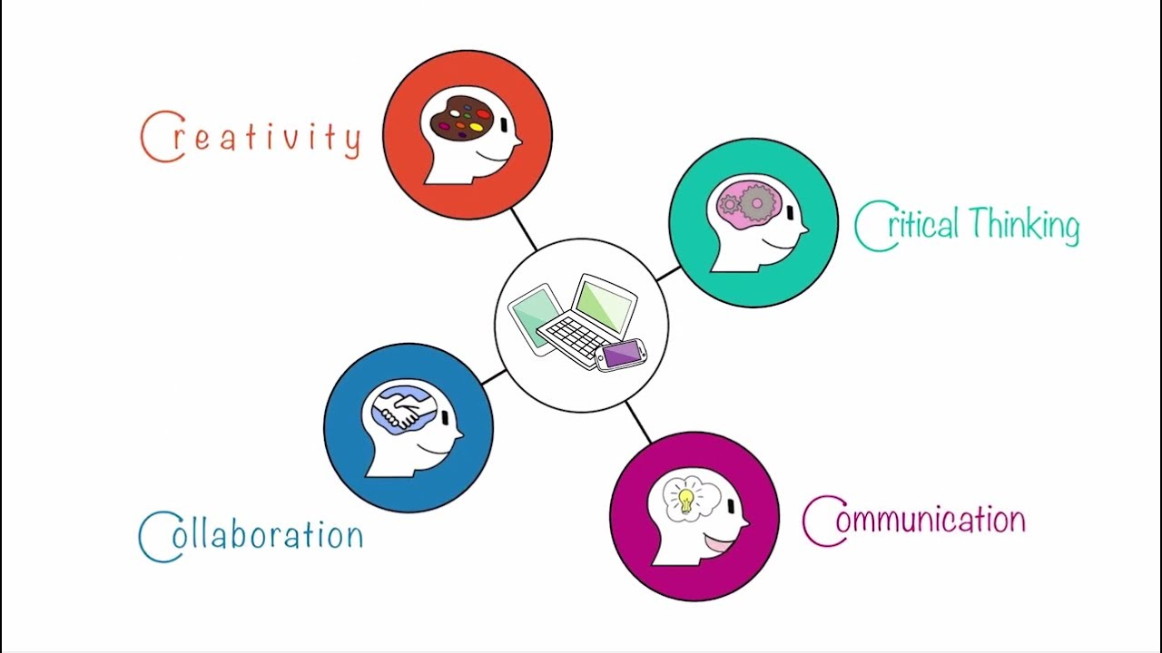

Slide 34
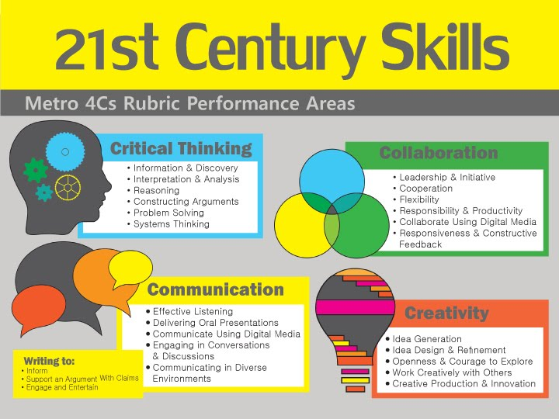

Slide 35
Decision Making
Problem solving involves making a series of decisions:
deciding that something is wrong,
deciding what the problem is, and
deciding how to solve it.

Slide 36
Decision Making
Successful problem solving depends on good decisions.
Decision: A choice from among available alternatives.

Slide 37
Decision Making
The rational model of decision making includes:
a. identify the problem
b. identify the alternative solutions
c. gather and organize the facts
d. evaluate the alternatives
e. select and implement the best alternative
f. get feedback and take corrective action.

Slide 38
Evaluate and Select solution
Force-field analysis :
It is a development in social science. It provides a framework for looking at the factors (forces) that influence a situation, originally social situations. It looks at forces that are either driving movement toward a goal (helping forces) or blocking movement toward a goal (hindering forces).
Feasibility and capability analysis:
Feasibility means looking at the design of the project or activity and asking, essentially, whether it is likely to work.
We need to consider things like the resources that the organisation will have available, the people who will be involved, the level of commitment that is demonstrated and, where possible, the organisation’s track record in its previous endeavours describes capability of the selection

Slide 39
Decision analysis:
It is a systematic, quantitative, and visual approach to addressing and evaluating the important choices that businesses sometimes face.

Slide 40
Evaluating problems:
Here are seven-steps for an effective problem-solving process.
Identify the issues. Be clear about what the problem is. ...
Understand everyone's interests. ...
List the possible solutions (options) ...
Evaluate the options. ...
Select an option or options. ...
Document the agreement(s). ...
Agree on contingencies, monitoring, and evaluation.

Slide 41
Choosing among alternatives
The essential steps in the process are:
Organize the alternatives to be considered. Identify dependencies.
Assign values to choices and groups of choices. ...
Decide on your objectives. ...
Apply a strategy to decide among alteratives in light of the assigned values and objectives. ...
Dependent decisions -- decision trees, fault trees.

Slide 42
Qualitative analysis
What is Qualitative Analysis?
Qualitative analysis uses subjective judgment to analyze a company's value or prospects based on non-quantifiable information, such as management expertise, industry cycles, strength of research and development, and labor relations.

Slide 43
Volume 75%
Discussing qualitative analysis techniques
Qualitative analysis uses subjective judgment based on "soft" or non-quantifiable data.
Qualitative analysis deals with intangible and inexact information that can be difficult to collect and measure.
Machines struggle to conduct qualitative analysis as intangibles can’t be defined by numeric values.
Understanding people and company cultures are central to qualitative analysis.
Looking at a company through the eyes of a customer and understanding its competitive advantage assists with qualitative analysis.

Slide 44
Establishing objectives
When those involved contribute to the creation of objectives, they are more likely to feel ownership with the work plan. Using the mnemonic specific, measurable, attainable, realistic, time based, or SMART method, gives an effective process to establish objectives.

Slide 45
Assigning weight to objectives in order to make the best decision
The Weighted Objectives Method is an evaluation method for comparing design concepts based on an overall value per design concept. ...
The Weighted Objectives Method involves assigning weights to the different criteria.
This allows the decision-maker to take into account the difference in importance between criteria.

Slide 46
Creating a satisfaction scale to choose between alternatives
It's a question that uses a 5 or 7-point scale, sometimes referred to as a satisfaction scale, that ranges from one extreme attitude to another.

